Slide 1

WWW.CHEMSHEETS.CO.UK
MOLAR RATIOS
© www.chemsheets.co.uk GCSE 1115 24-Dec-2016

Slide 2
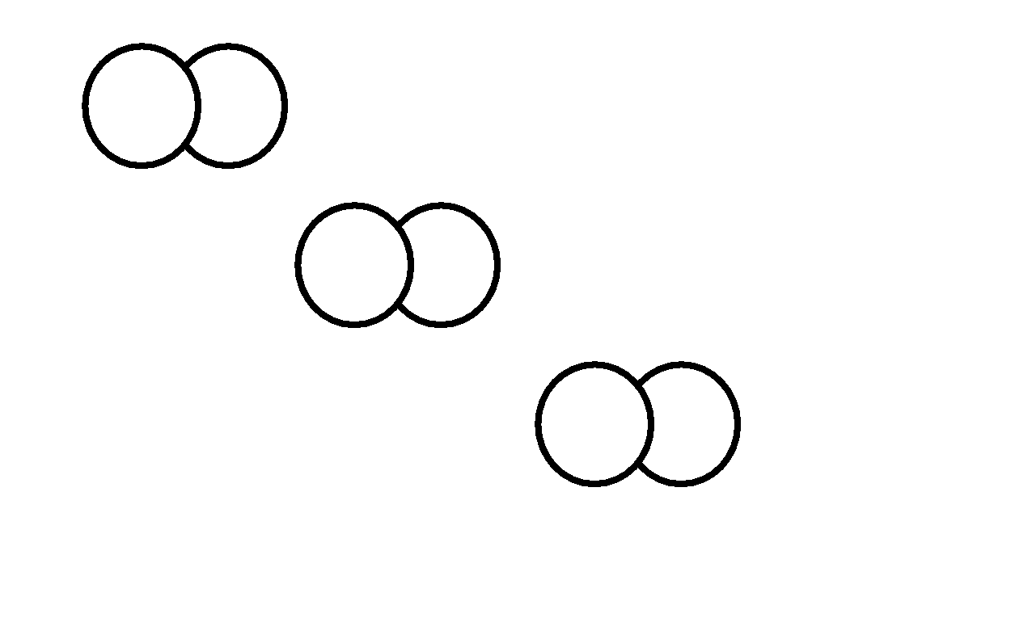
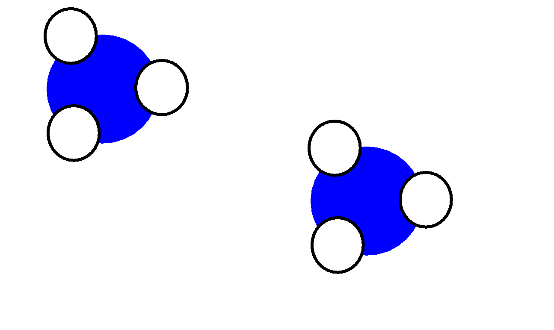
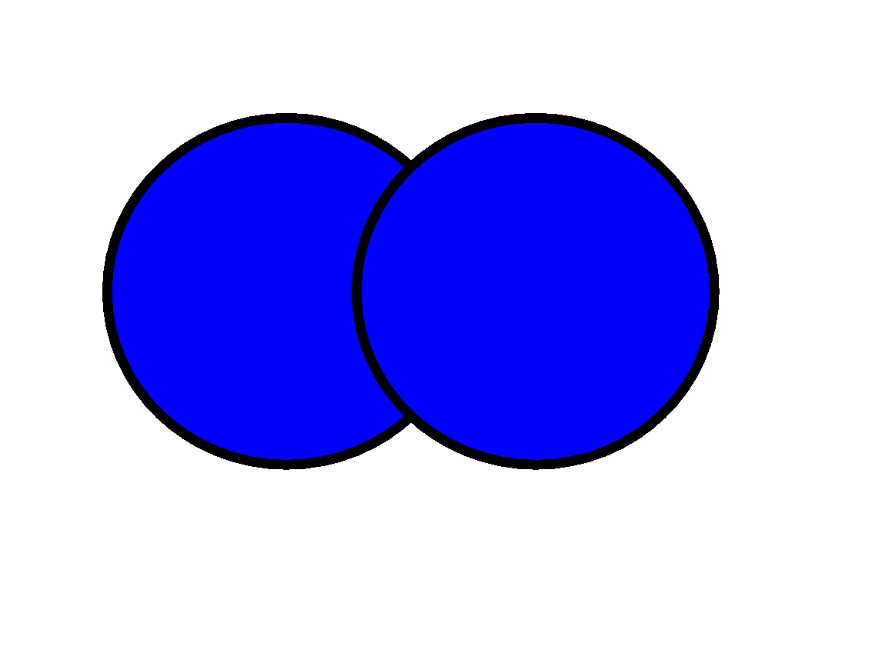
N₂ + 3 H₂
2 NH₃
1 molecule
3 molecules
2 molecules
12
36
24
1 dozen
3 dozen
2 dozen
6 x 10²³
18 x 10²³
12 x 10²³
600000000000000000000000
1800000000000000000000000
1200000000000000000000000
1 mole
3 moles
2 moles
© www.chemsheets.co.uk GCSE 1115 24-Dec-2016

Slide 3
N₂ + 3 H₂
2 NH₃
1 mole
3 moles
2 moles
10 moles
30 moles
20 moles
2 moles
6 moles
4 moles
0.5 moles
1.5 moles
1.0 moles
4 moles
12 moles
8 moles
© www.chemsheets.co.uk GCSE 1115 24-Dec-2016

Slide 4
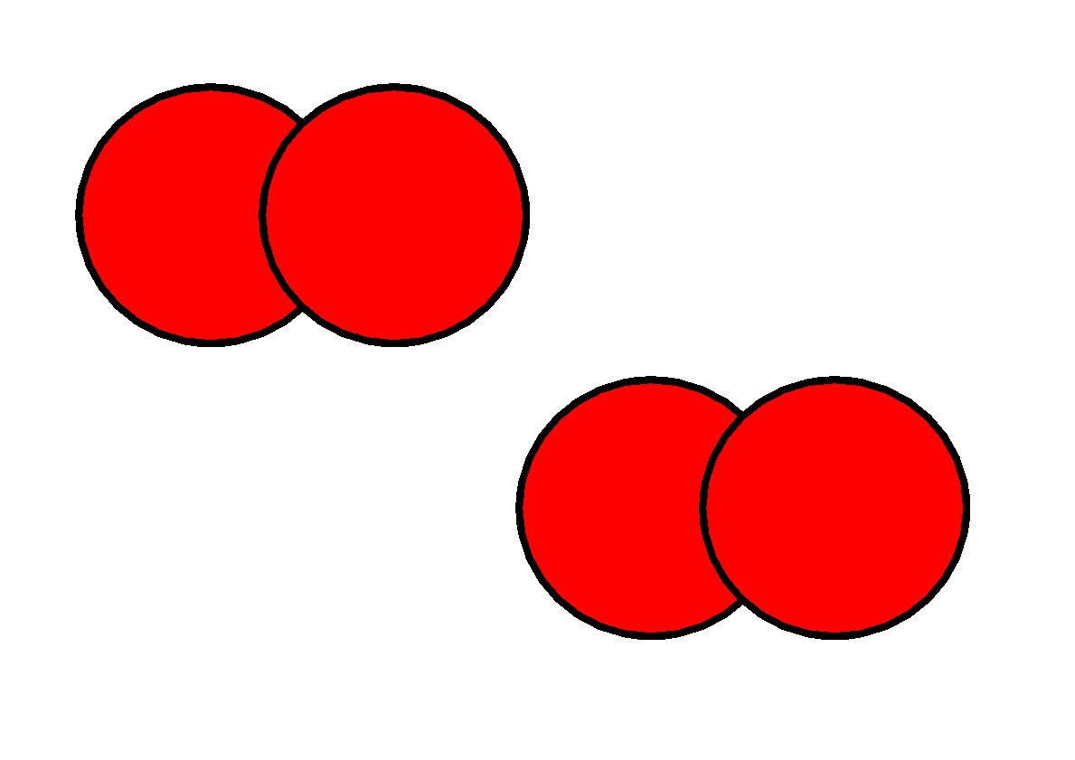
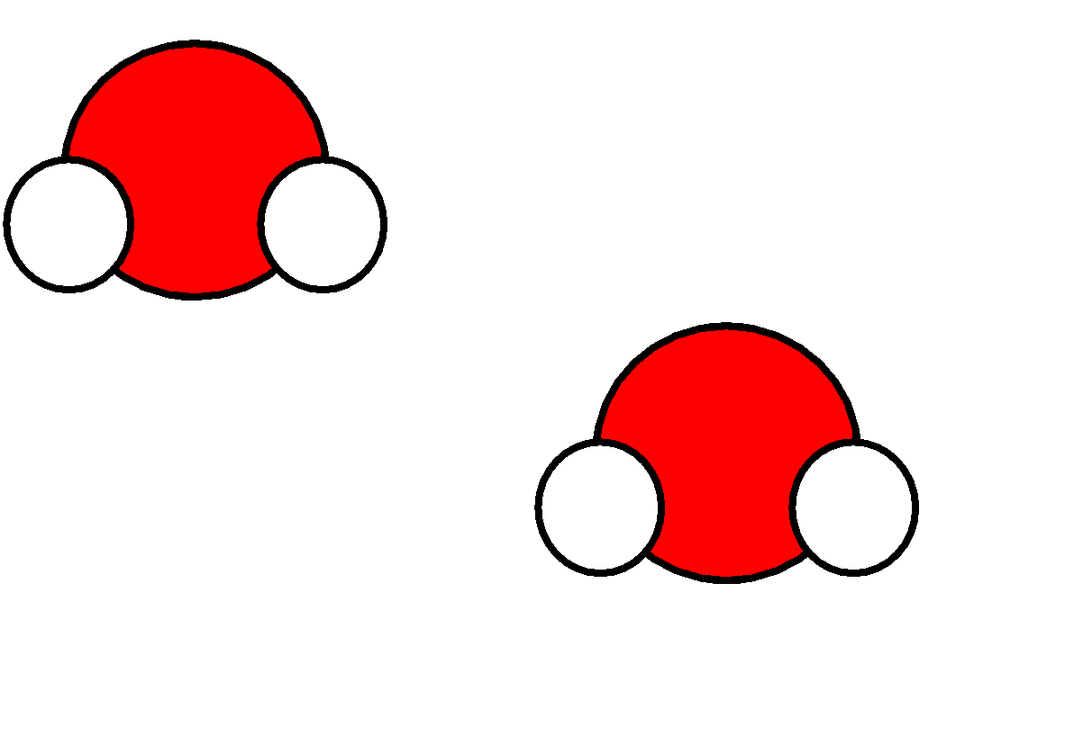



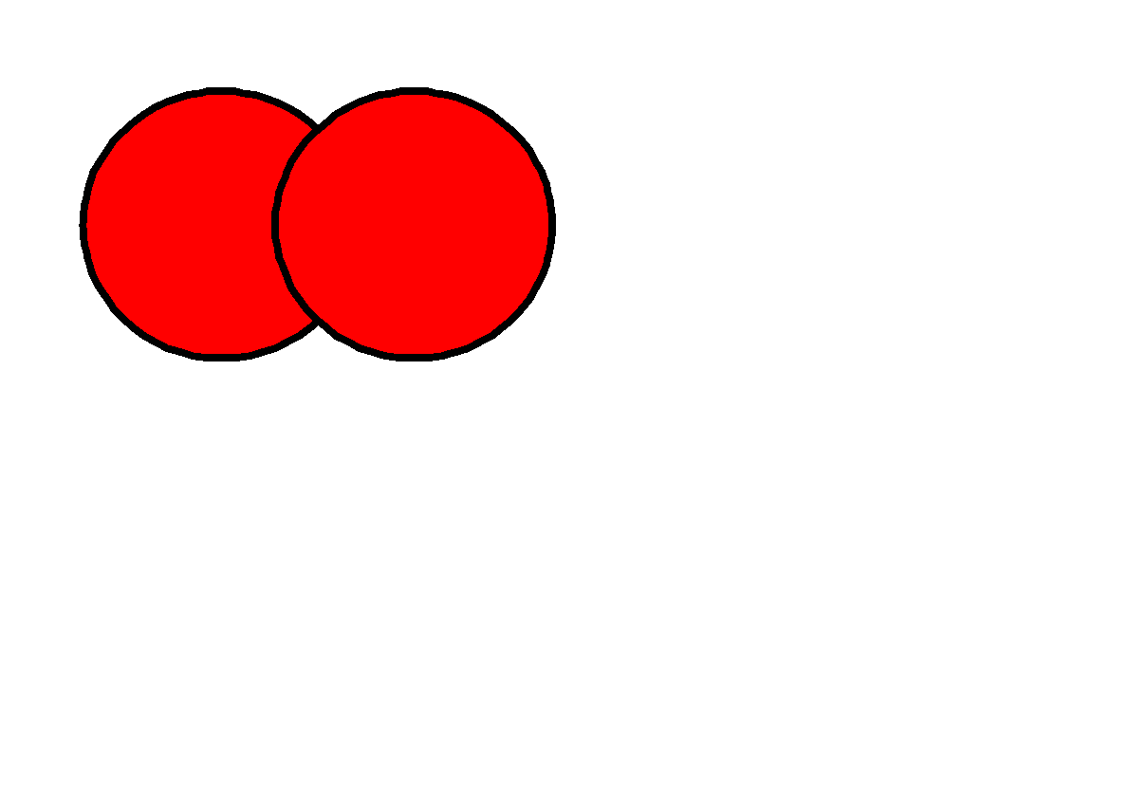
C₃H₈ + 5O₂
3CO₂ + 4H₂O
1 mole
5 moles
3 moles
4 moles
10 moles
50 moles
30 moles
40 moles
2 moles
10 moles
6 moles
8 moles
0.5 moles
2.5 moles
1.5 moles
2 moles
3 moles
15 moles
9 moles
12 moles
© www.chemsheets.co.uk GCSE 1115 24-Dec-2016

